Slide 1
Life Compass Explanaition
You are in the middle of the compass, surrounded by ten life domains that some people value: 1) Work / Career; 2) Intimate Relationship / Marriage, Couple; 3) Parenting; 4) Education / Learning; 5) Friends / Social life; 6) Health / Physical self-care; 7) Family (other than marriage and parenting); 8) Spirituality; 9) Community / Citizenship; 10) Recreation / Fun.
Read nº 1 of the following instructions, and perform what it is indicated without reading next point of the instructions. The same rule applies for the rest of points.
In the “i” small square of each large box, mark on a scale of 0, 1, or 2 how important these values are to you at this point in your life (0 = no importance, 1 = moderately important, 2 = very important). It’s okay if several squares all have the same score. Rate each are according to your own personal sense of importance.
If you rated an area as unimportant (0), leave void the main part of the corresponding large box. In the large box of each area rated (1), or (2), write a few key words about what is important or meaningful to you in this domain of life: What sort of person do you want to be in regards to (work / parenting / community / …)? What do you want to do? What sort of strengths or qualities do you want to develop? What do you want to stand for? (If a box seems irrelevant to you, that’s okay: just leave it blank. If you get stuck on a box, skip it and come back to it later. And it’s okay if the same words appear in several or all boxes.)

Slide 2
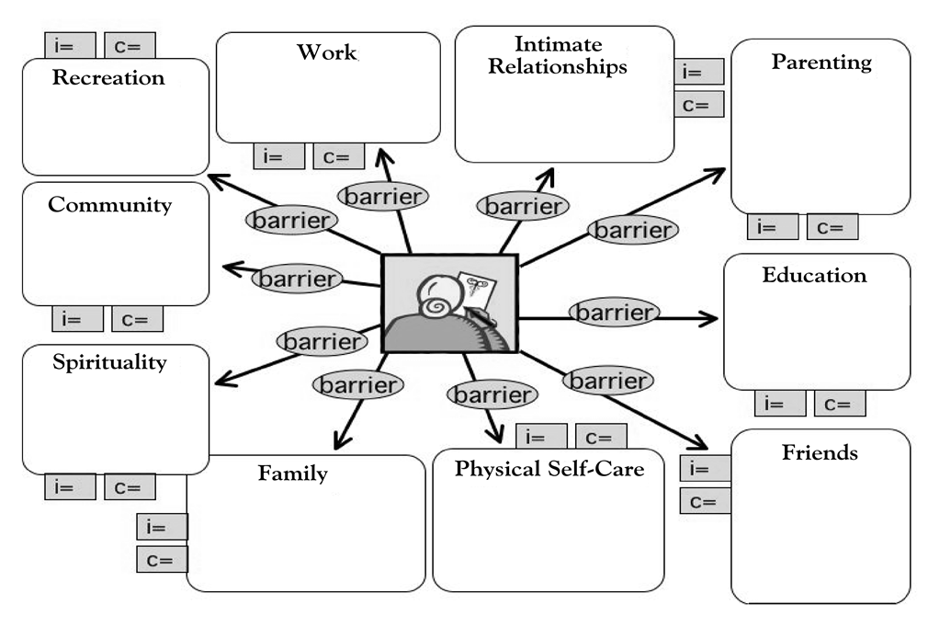
3. Finally, in the “c” small square of each large box, mark on scale of 0, 1 or 2 how effectively you are living by these values (0 = not at all, 1= moderately well, 2 = living by them full). Again, it’s okay if several squares all have the same score.
4. Now you have a good look at what you’ve written. What does it tell you about
i. what is important in your life?
ii. what are you currently neglecting?

Slide 3
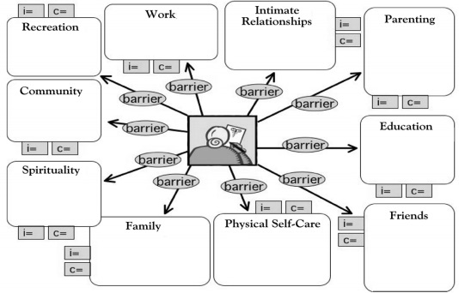
2
2
EXAMPLE
Poder trabajar si lo necesito
Disciplina de trabajo
Autoexigirme en el trabajo
2
Pasarlo bien en mi vida, reir
Dedicar tiempo a mis hobbies
Viajar, cosas nuevas
Ser querido y querer mucho
Disfrutar y reir siempre, nada de malos rollos
Preocuparme por mi novia
2
1
0
Ser buena persona
Hacer el Bien
Prestar servicios a los demás, hacer cosas por los demás
Falta motivación
Falta tiempo
0
Prioridad otras personas antes
Seguir estudiando cosas que me interesan
Mantener el cerebro activo
Disfrutar aprendiendo
2
1
Dedicar tiempo a pensar en ello
Autoconocerme mejor
Ver qué quiero en la vida
2
2
2
2
2
1
1
Mantener las amistades a pesar de la distancia
Ser un buen amigo
Preocuparme por mis amigos/ayudarles
Querer a mi familia
Preocuparme por ellos
Pasar tiempo juntos
No discutir con ellos
Estar en forma
Mejorar mi Crossfit
Comer saludable
Estar contento con mi cuerpo
2
2
2

